Slide 1
Teaching Debugging Workshop
Empower {MN:CS}
2025

Slide 2
Goals for Today
Apply our learnings (open-endedness, conflict, emotion) to a practical resource you will use in your teaching
Practice our materials and understanding in sharing pairs (maybe simulations with David Melchionne-Martinez this afternoon? 🤞🏻)

Slide 3
Pick your resource (10 minutes)
Can be something new, or updating an existing work
We want you to leave with something practical that you will be able to use
Some ideas:
A lesson plan you will use in your classroom
A new classroom strategy around failure or debugging
Materials for other teachers in your school or department
Scope and sequence around debugging or refactoring plans for your school, district, or program
Classroom strategies or norms

Slide 4





Computer Science Values
Testing | Failure | Pairing | Security | Shipping

Slide 5
Failure
What will we do when things don’t work?
Doesn't work.
It's been a lot of stress; for a chain this big, I'm surprised how buggy this app is.

Slide 6
Topic share out/groups (10 minutes)
Please share out:
What you’ll work on?
What grade level?
What technologies?
We’ll group up around common areas

Slide 7
Work time (50 minutes)
How can you update this resource to reflect:
Open-endedness
How can you make room for a variety of student solutions?
Conflict
How can you clarify and balance student and instructor goals during debugging?
Emotion
How can you leverage and support student emotion during debugging?
David and Clay are available for breakouts!

Slide 8
Wrap up (15 minutes)
Popcorn share out:
What did you work on?
What are your next steps?
What support do you need?

Slide 9
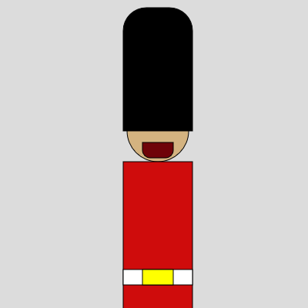
rect() student example

